Slide 1
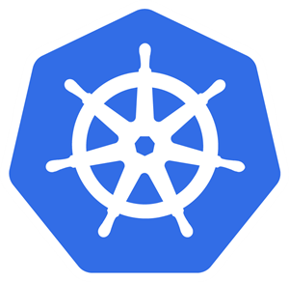
Moving To Production with Kubernetes

Slide 2
Kubernetes is an operating systems for clusters

Slide 3
What Is Kubernetes
A Cluster is a collection of servers
Kubernetes is an “Operating System” that manages applications running in a cluster

Slide 4
What Is Kubernetes
Server1
Server2
Server3
Server4
Kubernetes
Web App
DB

Slide 5
Kubernetes Is Responsible For:
Kubernetes starts up applications
Kubernetes watches them
Kubernetes restarts them if they fail
Kubernetes gives them more resources if they need

Slide 6
Server1
Server2
Programs are Images
Kubernetes
Processes are Containers
mongo
redis
ynonp/my-webapp

Slide 7
Installations
Cluster state is saved internally
We install a new “application” by sending a manifest to the cluster

Slide 8
Example: Manifest to Install nginx
apiVersion: apps/v1
kind: Deployment
metadata:
labels:
io.kompose.service: nginx
name: nginx
spec:
replicas: 1
selector:
matchLabels:
io.kompose.service: nginx
strategy: {}
template:
metadata:
labels:
io.kompose.service: nginx
spec:
containers:
- image: nginx
name: nginx
ports:
- containerPort: 80
resources: {}
restartPolicy: Always
status: {}

Slide 9
Pods, Deployments and Services

Slide 10
Pod Is A Container (usually)
Server1
Server3
Server4
Web App - Pod
DB
DB
DB
Kubernetes

Slide 11
Deployment is an installation
Nginx Deployment
Kubernetes

Slide 12
Service
Server1
Server3
Server4
Web App - Pod
DB
DB
DB
Web App Service
DB Service

Slide 13
Next Steps
Get
Get a cluster
Deploy
Deploy some apps

